Slide 1
Fundamentals of Reporting
Finance

Slide 2
Agenda
Chartfield Structure
EBI: Budget to Actual Reporting
EBI: Revenue & Expense Transaction Detail Report

Slide 3
Chartfield Structure
Full Chartfield Combination (example)
Chartfield Guide
Need Operating Unit 18000 for entry in EBI reporting
Need your Department ID for entry in EBI reporting
Need Fund of the Department or Project to run an EBI report
Program of the Department or Project is optional to run an EBI report
Event of the Department or Project is optional to run an EBI report
Need your Project ID for entry in EBI reporting

Slide 4
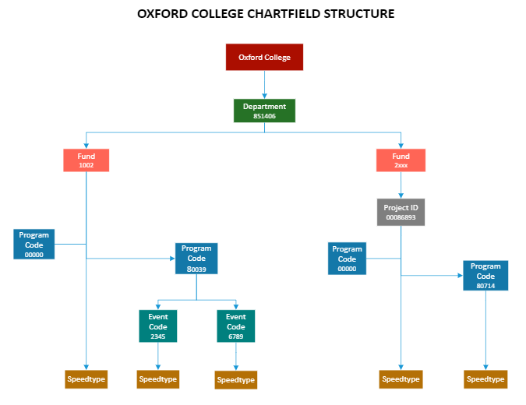
Example

Slide 5
EBI: Budget to Actual Reporting

Slide 6
EBI: Budget to Actual Reporting Summary & Detail Reports by Fund Category
What are the Summary & Detail Reports by Fund Category?
The reports compare the loaded Budget to Actuals (transactions) and shows a summary view of the budget available at the account level, based on your prompt selections.
The report is divided by fund groups into Unrestricted Operating Budget, Non‐Sponsored Projects, and Sponsored Projects.
When should I use the Summary & Detail Reports by Fund Category dashboards?
Use this report if you are looking for the available budget of an Operating Unit, Department, Project, Award, etc. when comparing the Budget to Actuals.

Slide 7
EBI: Budget to Actual Reporting Summary & Detail Reports by Fund Category
Where do I find this report in EBI?
1. Log in to EBI: https://dwbi.emory.edu/analytics or access via https://finance.emory.edu, then click Emory Business Intelligence tile
2. Click on the Dashboards Menu in the upper right corner.
3. In the FMS – Operational folder, click the Budget to Actual Reporting link.

Slide 8
EBI: Budget to Actual Reporting Summary & Detail Reports by Fund Category
Understanding the Fund Categories
The Unrestricted Operating Budgets page includes transactions with fund codes beginning with 1XXX.
The Non‐Sponsored Projects page includes transactions with fund codes beginning with 2XXX, 3XXX, 4XXX, 6XXX, 7XXX, 8XXX, and 9XXX.
The Sponsored Projects page includes transactions with fund codes beginning with 5XXX.

Slide 9
EBI: Budget to Actual Reporting Summary & Detail Reports by Fund Category
Unrestricted Operating Budgets (UOB)
Selecting Prompts:
Select a Fiscal Year and Accounting Period
The report will default to the current Fiscal Year and the last closed Accounting Period
2. Select a Department
3. Select other prompts as needed
4. Click Apply

Slide 10
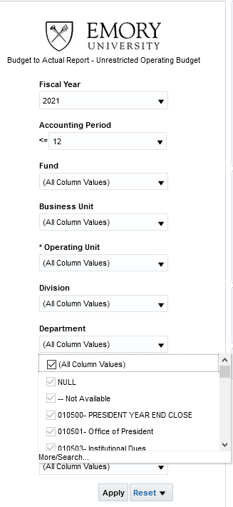
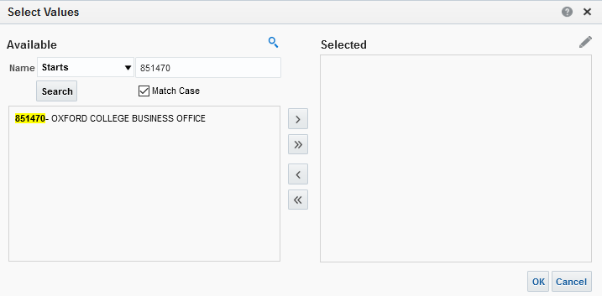
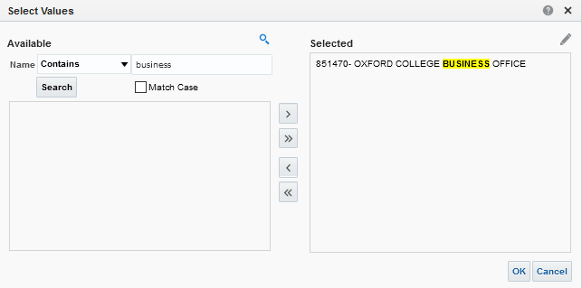
5
1
2
6
5
8
7
Unselect
3
9
Unselect
4
11
10

Slide 11
EBI: Budget to Actual Reporting Summary & Detail Reports by Fund Category
UOB Summary – this view shows your FYTD Original Budget, FYTD Budget Revisions, a total FYTD Budget, Month to Date (MTD) and Fiscal Year to Date (FYTD) Actuals, LTD Encumbrances, a FYTD Budget Available, and % Used FYTD by Department.
TIP: While UOB budgets and actuals are held to the fiscal year, Encumbrances roll over across fiscal years. This is why the Encumbrance column is Life to Date (LTD).
TIP: In this view, the Budget Available column is calculated as: Budget – FYTD Actual – LTD Encumbrance

Slide 12
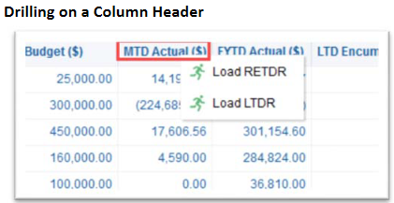
EBI: Budget to Actual Reporting Summary & Detail Reports by Fund Category
Left click on the blue hyperlink in column header, then click Load RETDR – get all the data in that column
FYTD Actual column will load the “Revenue & Expense Transaction Detail Report” (RETDR)
Left click on the blue hyperlink on specific cell, then click Load RETDR – get data for that amount

Slide 13
EBI: Budget to Actual Reporting Summary & Detail Reports by Fund Category

Slide 14
EBI: Budget to Actual Reporting Summary & Detail Reports by Fund Category
UOB Detail – this view shows all of the columns available in the UOB Summary view by Department, plus additional columns for Account Class, Account Group, Account Category, Account, Fund, Program, and Event.
The UOB Detail view also shows a subtotal by Account Category, Account Group, and Account Class.
UOB Summary No Encumbrance – this view is a duplicate of the UOB Summary view but excludes the Encumbrance column.
In this view, the Budget Available column is calculated as: the FYTD Budget – FYTD Actual.
UOB Detail No Encumbrance – this view is a duplicate of the UOB Detail view but excludes the Encumbrance column.
You may wish to run the No Encumbrance views toward the end of a Fiscal Year.
UOB Detail Export View – this view displays a table view of the data that can easily be exported to Excel or CSV.

Slide 15
Questions?

Slide 16
EBI: Revenue & Expense Transaction Detail Report (RETDR)

Slide 17
EBI: Revenue & Expense Transaction Detail Report (RETDR)
What is the Revenue & Expense Transaction Detail Report?
The Revenue & Expense Transaction Detail Report provides detailed information for transactions that have posted to the revenue, expense, and transfer account codes. This includes account codes 4XXXX, 5XXXX, 6XXXX, 7XXXX, 8XXXX, and 9XXXX.
Only transactions that have posted to the General Ledger will display here. Transactions pending approval and encumbrances will not show on this report until after approval or payment of invoices, respectively.
Salary and Fringe transactions will post as an aggregate at the account code level, but additional Labor details are not visible on this report, due to Labor Security.
This report is the replacement for the ALLTRANS query in Compass.

Slide 18
EBI: Revenue & Expense Transaction Detail Report (RETDR)
When should I use the Revenue & Expense Transaction Detail Report?
Use this report if you are looking for details related to transactions that have posted to the General Ledger.
Transaction details include, but are not limited to, information like: Chartfields, Transaction Dates, Transaction Submitters, Transaction or Item descriptions, etc.

Slide 19
EBI: Revenue & Expense Transaction Detail Report (RETDR
Where do I find this report in EBI?
1. Log in to EBI: https://dwbi.emory.edu/analytics or access via https://finance.emory.edu, then click Emory Business Intelligence tile
2. Click on the Dashboards Menu in the upper right corner.
3. In the FMS –Operational folder, click the Revenue & Expense Transaction Detail Report link.

Slide 20
EBI: Revenue & Expense Transaction Detail Report (RETDR)
Understanding the Dashboard Pages
Revenue & Expense Detail is the default page for the dashboard and displays transaction details based on the prompted values in a table format.
Revenue & Expense Summary (Journal) displays a summary of actuals at the Chartfield Level and Journal Source. It shows fewer detail than the default page. (not covered in training)
Revenue & Expense Detail Vendor Inquiry page allows users to prompt on specific Vendors and see all transactions for those Vendors within the prompted timeframe. (not covered in training)

Slide 21
EBI: Revenue & Expense Transaction Detail Report (RETDR)
Revenue & Expense Detail Page
Selecting Prompts:
Select the Reporting Begin Date and Reporting End Date. The default Begin Date is September 1 of the current fiscal year. The default End Date is today’s date
If a specific Fund Group is needed, uncheck “All Column Values” and select the fund group(s) you wish to see data for. Otherwise, you can leave the default selection of “All Column Values”
Select 18000 in the Operating Unit prompt
Select a value in either a Department or Project prompts and any other prompt values needed
Multiple values can be selected in a single prompt
5. Click Apply

Slide 22
1
6
2
4
Unselect
3
or
or
5
4
7
6
Unselect
9
8
Unselect
10
5
11
12

Slide 23
EBI: Revenue & Expense Transaction Detail Report (RETDR)
Transaction Detail View is the default report view and displays a table of transactions that have posted, sorted by Account Code.
All EBI reports default sort by the left most column. Sort can be modified by moving a different column to the far-left side of the table or using Sort customization option by right clicking on any column header.
Extended Detail View includes all the columns in the Transaction Detail View plus additional columns and is sorted by Journal Source.
Table View includes all columns and/or exporting.
TIP: Need additional information? Try to customize any of these views by including columns that may be excluded. Right click on any column header and choose “Include Column” to see what additional data is available for this report.

Slide 24
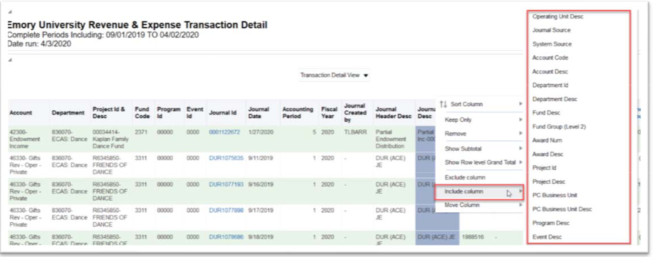
EBI: Revenue & Expense Transaction Detail Report (RETDR)
Excluded Columns on the Revenue & Expense Detail Page Reports:
The Revenue & Expense Detail reports have many excluded columns that can be useful for users.
For a comprehensive list of available columns, simply right click on any column header and choose Include Column.

Slide 25
EBI: Revenue & Expense Transaction Detail Report (RETDR)
Excluded Columns on the Revenue & Expense Detail Page Reports:
Listed below are some commonly used columns that many users find helpful to include in their customizations on the Revenue & Expense Detail Page.
Speedtype: this column displays the unique code associated with the activity/program
Accounting Line Desc: this column serves as a “catch all” for various pieces of information. It includes data such as, but not limited to, the Emory Express item (i.e., the type of pen ordered from Staples), ticket number and passenger name for direct billed airfare, etc.
Merchant: this column displays the Merchant for a Corporate Card or Purchasing Card transaction.
Purchaser Name: this column displays the NetID of the person that submitted a Purchase Order in Emory Express.
Expense Report ID: this column displays the actual Expense Report ID for an approved expense report.

Slide 26
Questions?

Slide 27
Resources
Budget to Actuals Reporting
Revenue & Expense Transaction Detail Report
Point of Contact
Oxford Finance website
Emory Finance website
Emory Finance Job Aid Library

